Slide 1
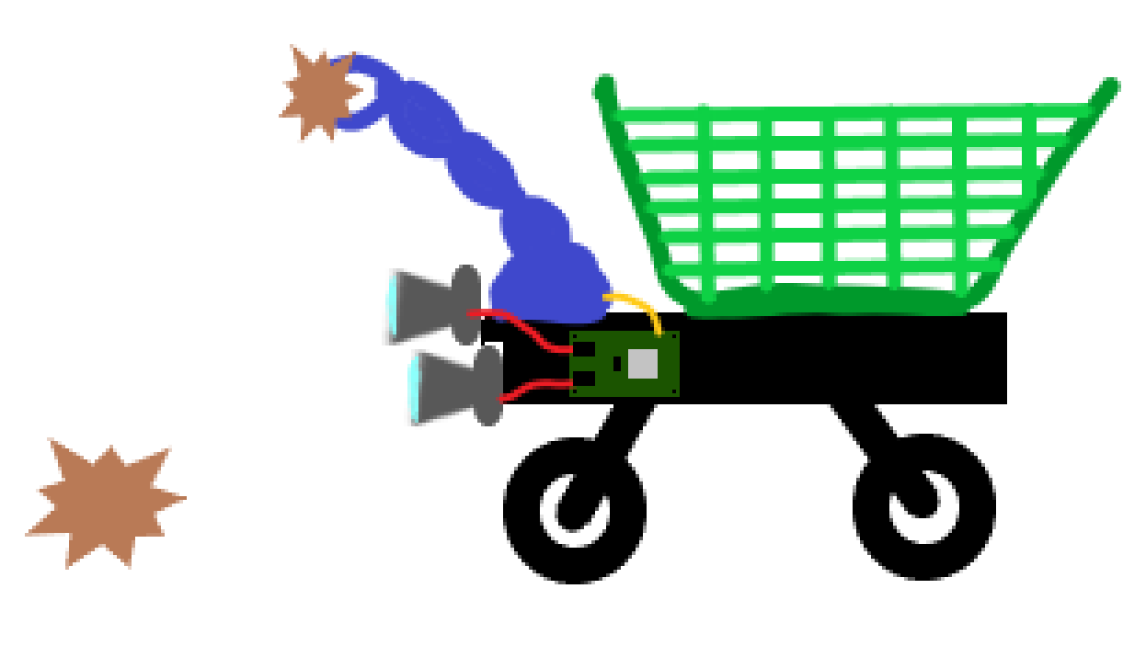
Stereo Visual odometry

Slide 2
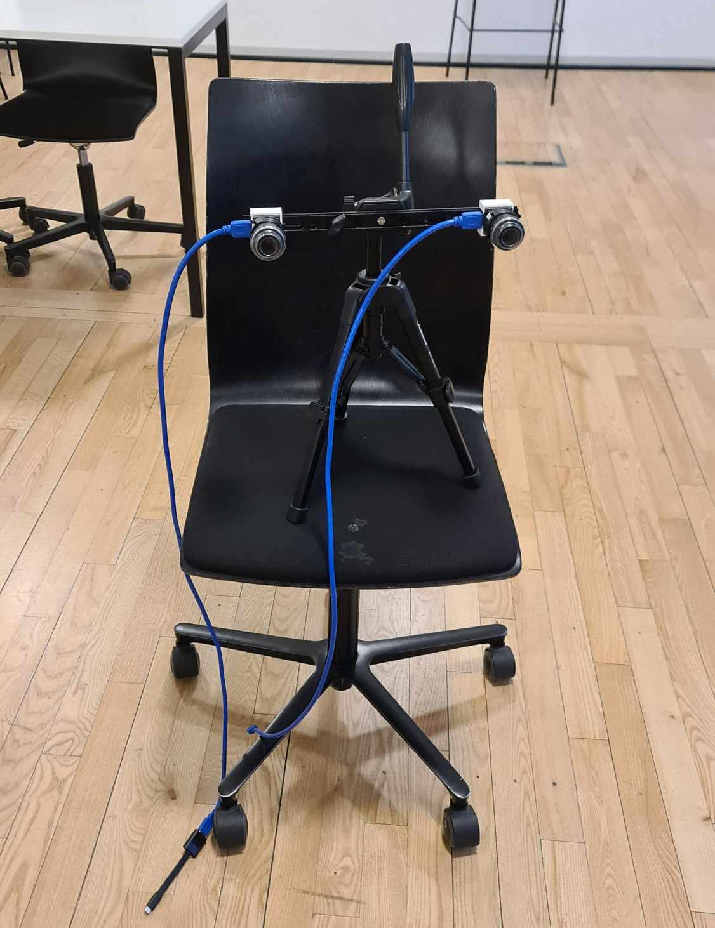
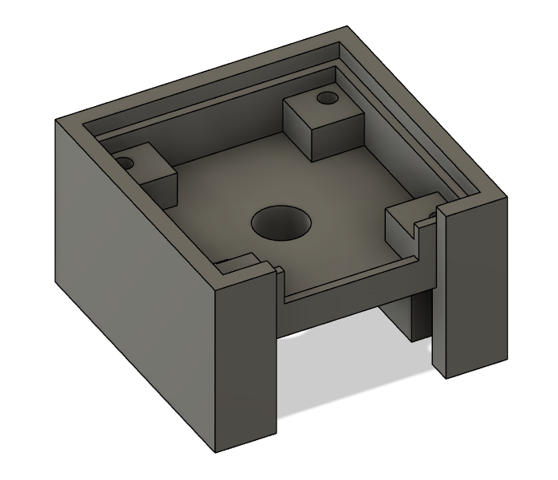
Test setup

Slide 3
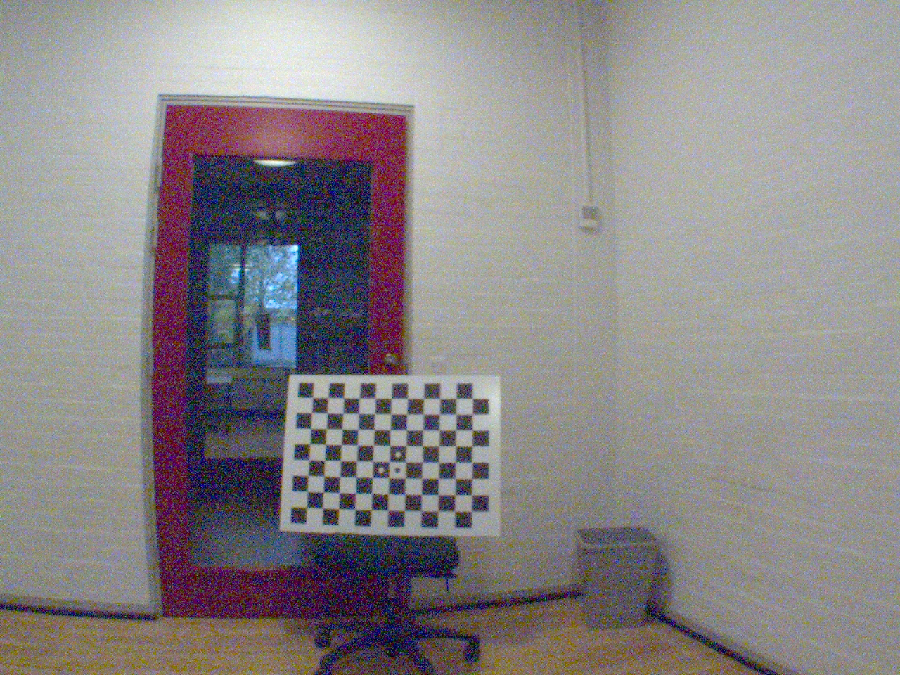
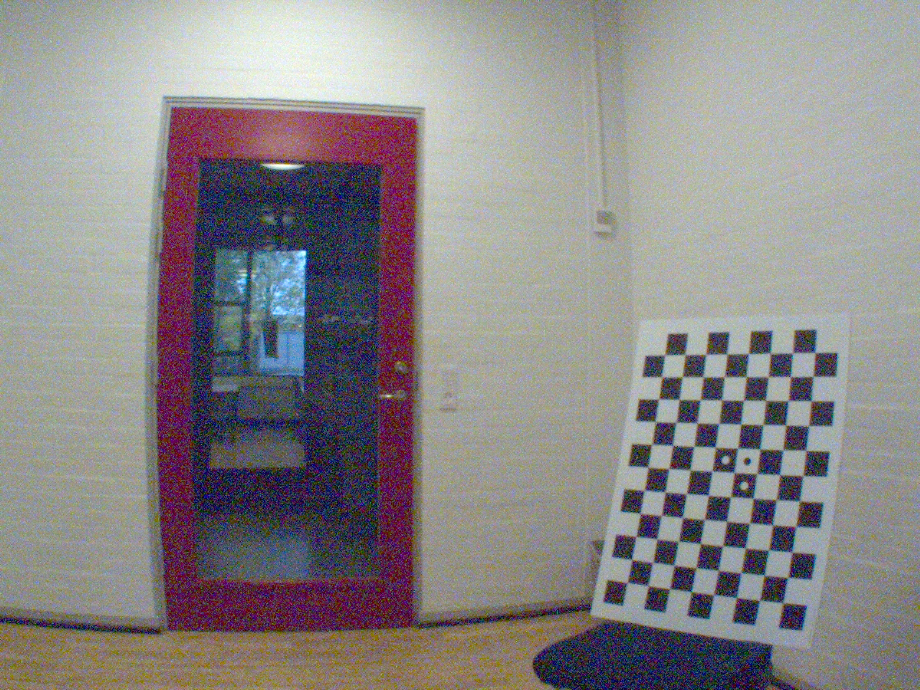
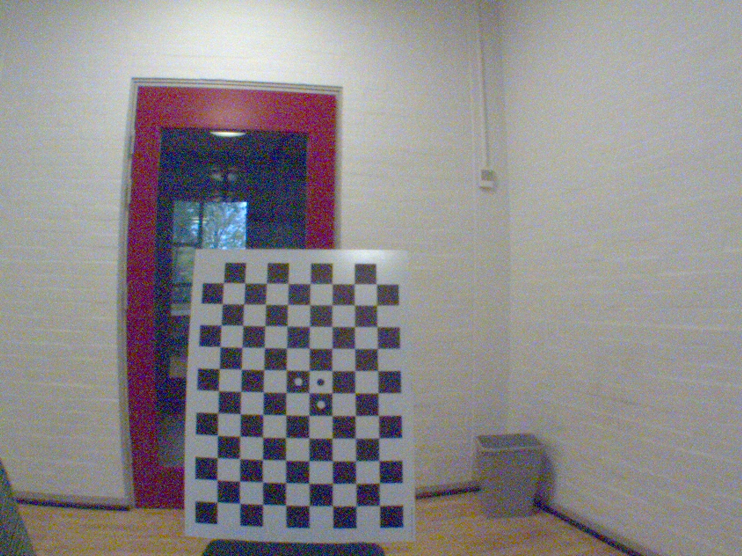
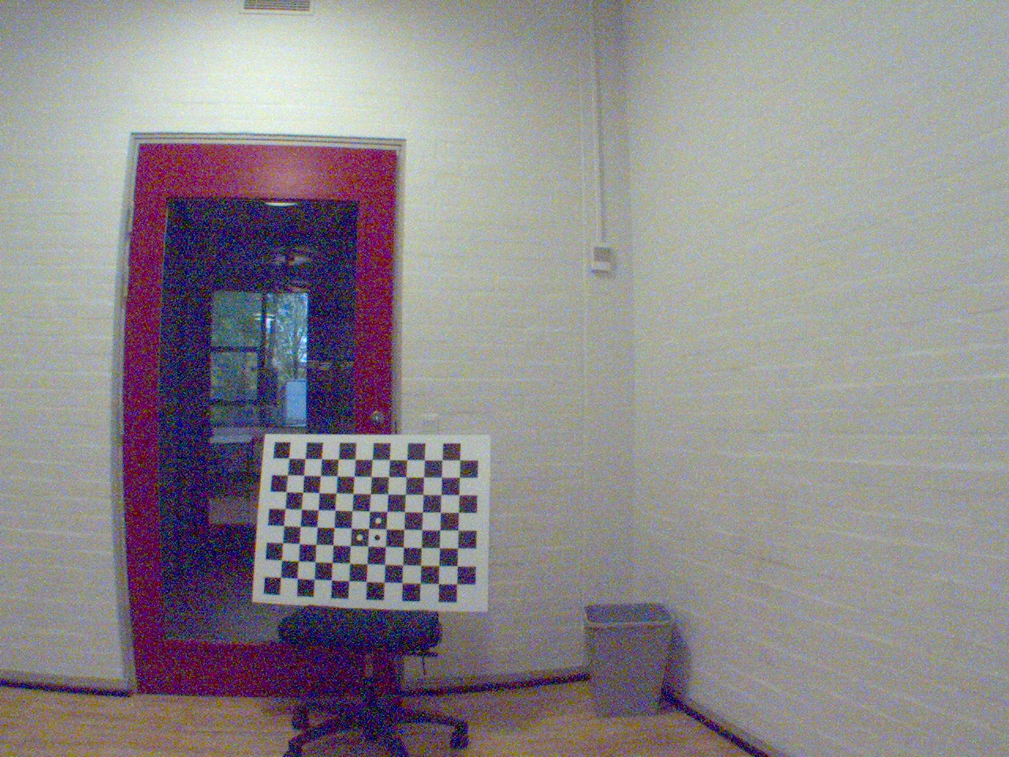
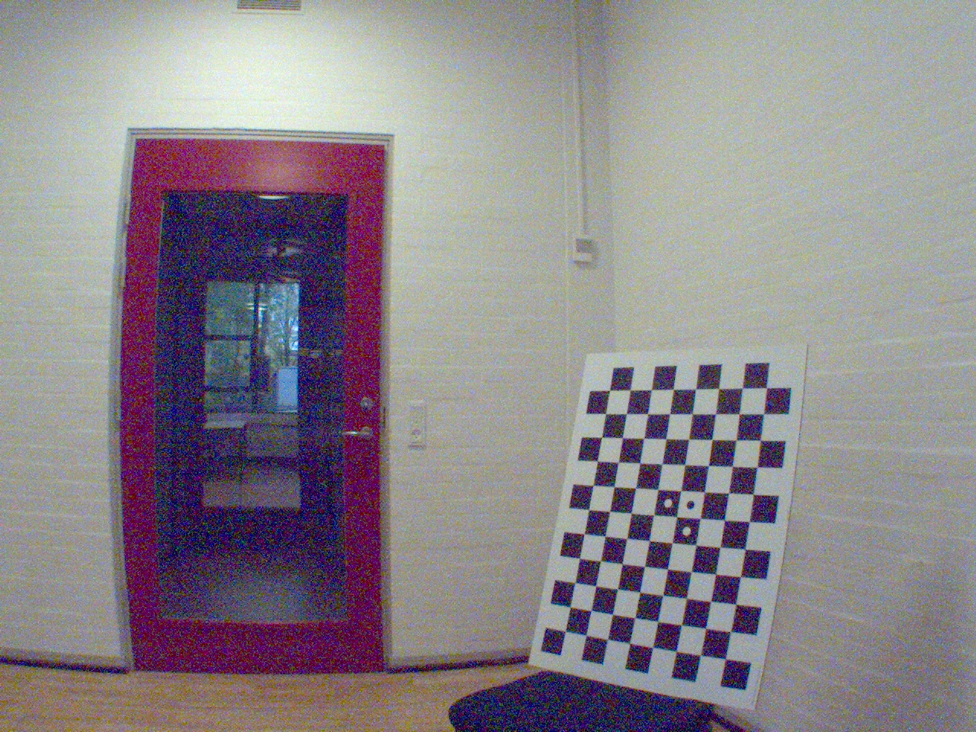
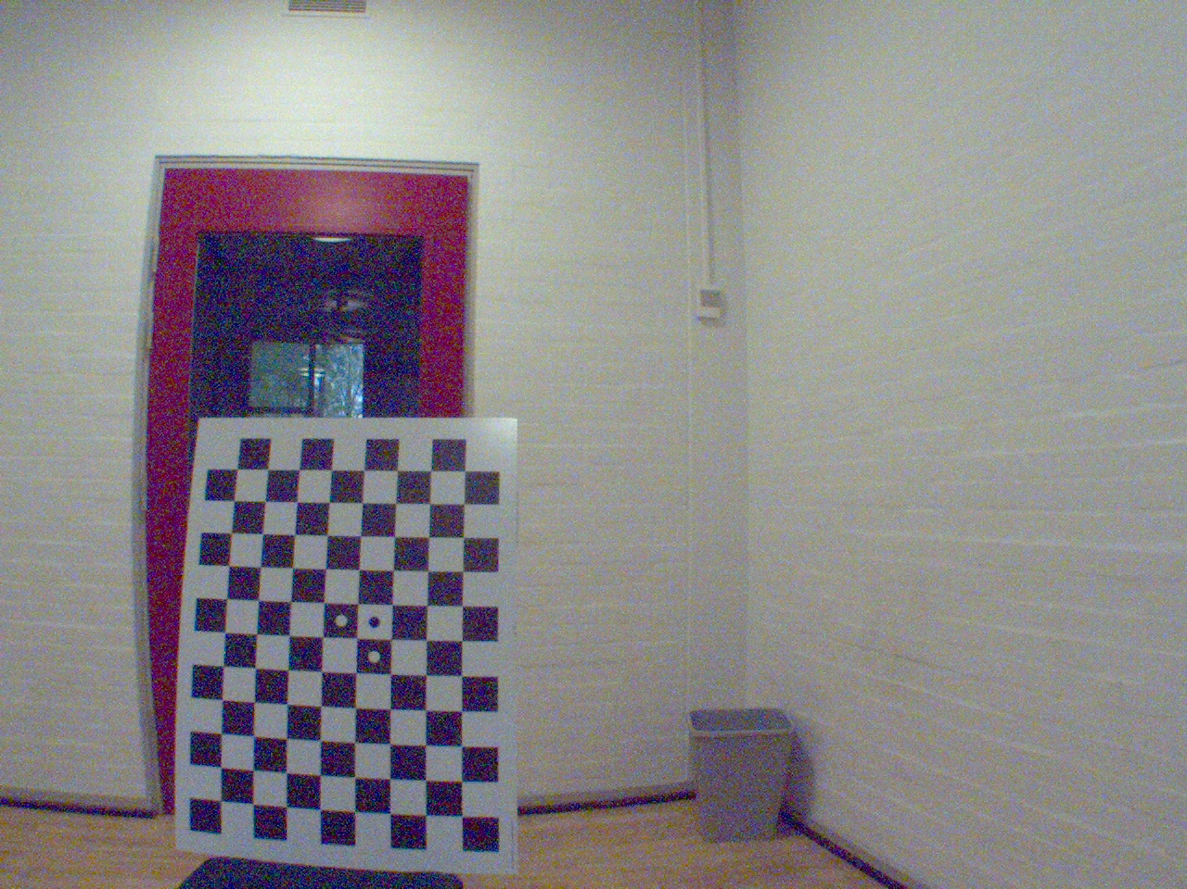
Calibrations data
L
R

Slide 4
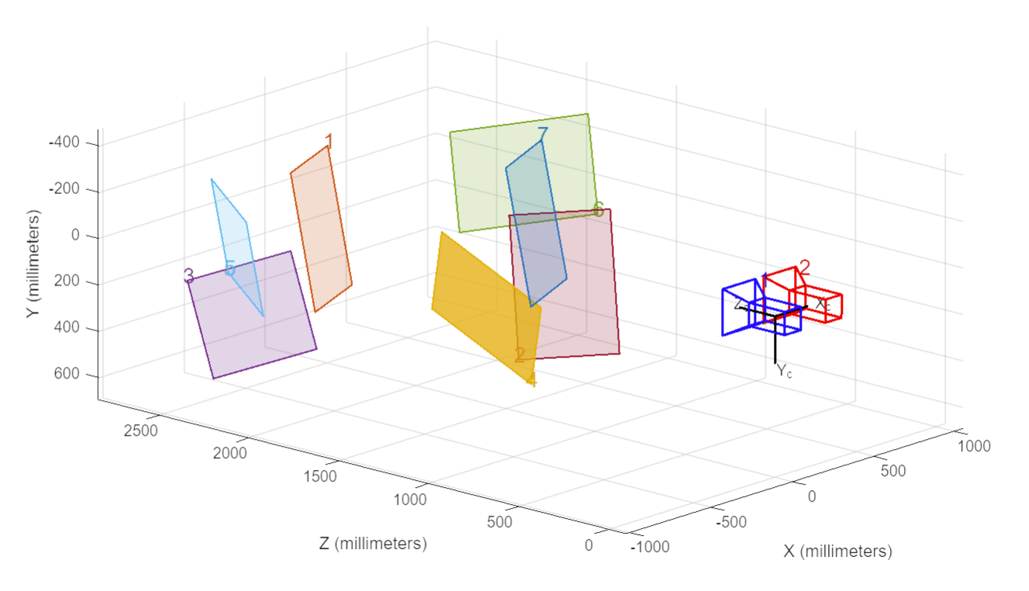
Calibrations and rectification

Slide 5
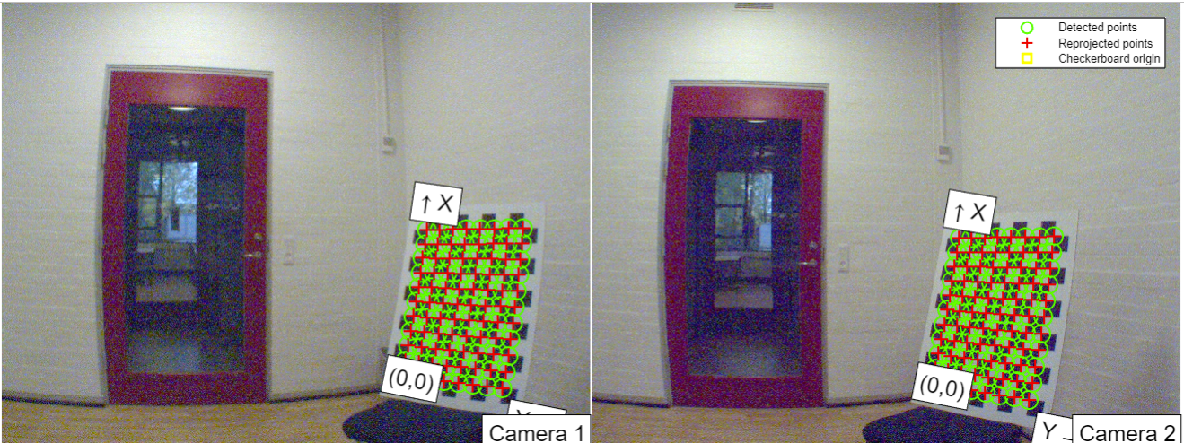
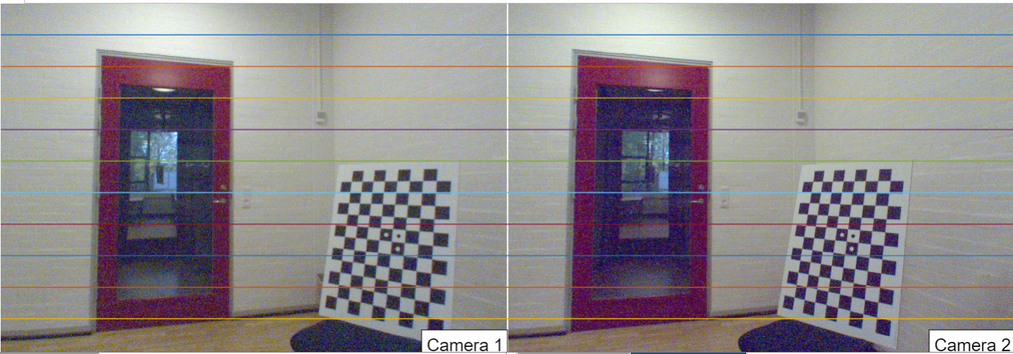
Pre rectification
Post rectification

Slide 6
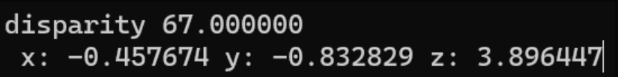
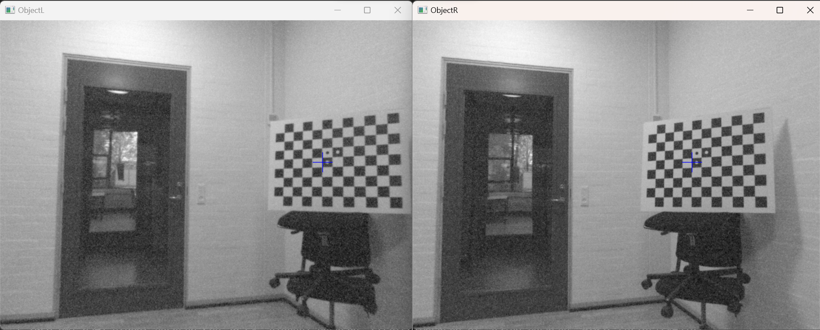
Current status
-Camera settings -> more light to the censor
-Stereo matching fine tune
https://media.discordapp.net/attachments/817042285430571058/1168469334444744744/image.png?ex=6551e0de&is=653f6bde&hm=34c0bbdadf77ddc51ba5f15235496476763cf2bcb6f42179bcb2066fde2081c6&=&width=1440&height=579

Slide 7
Sum of absolute differences – Feature tracking

Slide 8

Questions
Rectification of single points?

Slide 9
